Slide 1
Pharmacy Management System
Team 10
Project
April 11, 2024

Slide 2




Akshay Datir
Anusha Poojary
Ayush Yadav
Sahil Mutha

Slide 3
PROBLEM STATEMENT
Pharmacies face challenges in managing inventory, customer transactions, and overall operations efficiently.
Manual processes in pharmacy management can lead to errors, delays, and inefficiencies.
Lack of automated systems makes it difficult to track inventory levels accurately, leading to stockouts or excess stock.
Customer service may be affected due to slow checkout processes and inadequate access to prescription information.
There is a need for a comprehensive solution to automate pharmacy management tasks and improve workflow efficiency.

Slide 4
OBJECTIVES
Streamline Pharmacy Operations: Develop a system that simplifies and automates various pharmacy processes, including inventory management, customer transactions, and employee scheduling.
Enhance Inventory Control: Implement robust inventory tracking mechanisms to ensure accurate stock levels, minimize wastage, and prevent stockouts.
Improve Customer Service: Enable faster checkout processes, provide easy access to prescription information, and maintain detailed customer records for personalized service.
Ensure Data Security: Implement role-based access control and encryption mechanisms to safeguard sensitive pharmacy and customer data.
Facilitate Reporting and Analysis: Develop views and reports to provide insights into inventory status, customer purchasing patterns, and financial performance.

Slide 5
SOLUTION
Implement a centralized database system to manage inventory, customer data, prescriptions, and employee information efficiently.
Develop user-friendly interfaces for pharmacy staff to input and access information easily, improving workflow efficiency.
Incorporate inventory management features to track stock levels, receive alerts for low inventory, and generate reports for restocking.
Ensure secure access control mechanisms to protect sensitive information and restrict unauthorized access, maintaining data privacy and confidentiality.

Slide 6
ER Diagram

Slide 7
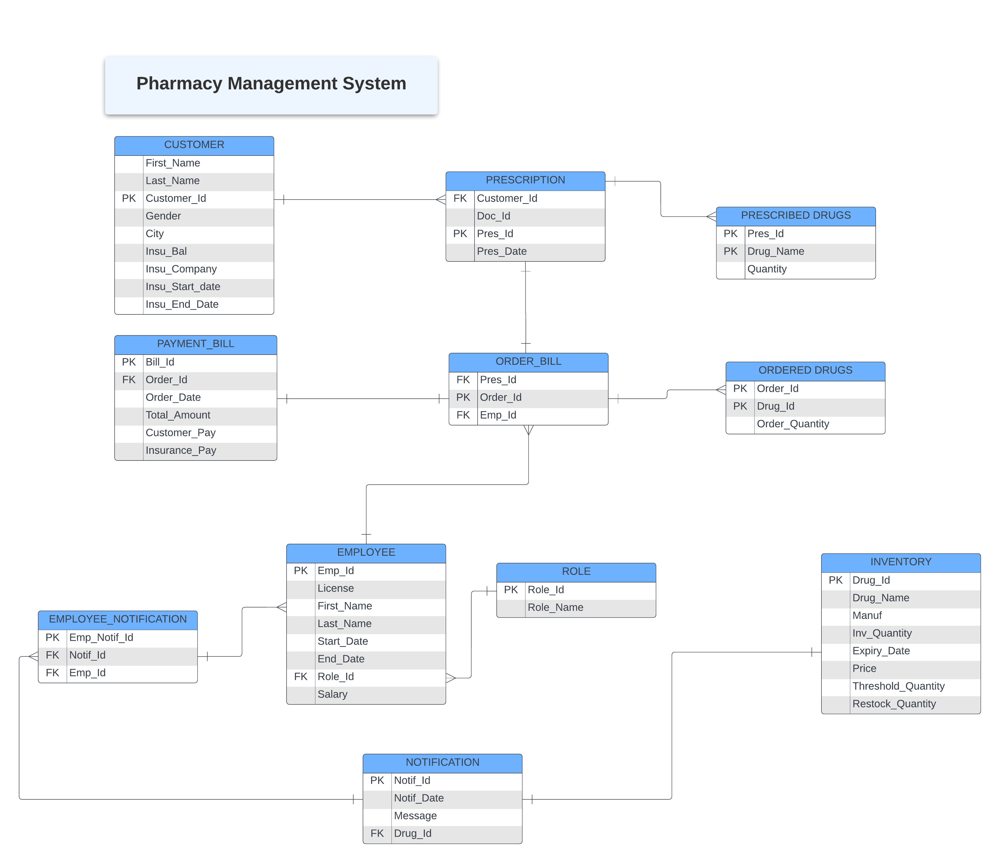

Slide 8
Data Flow Diagram

Slide 9
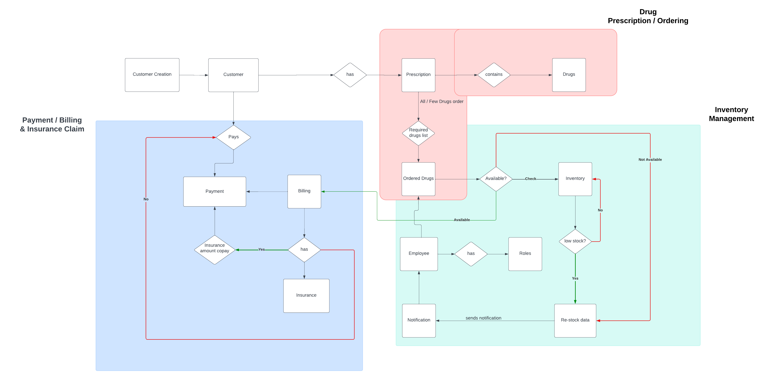

Slide 10
Views and Reports

Slide 11
Low Inventory Drugs Status
Objective: To identify drugs running low in inventory based on a specified threshold quantity.
Justification: Timely restocking prevents stockouts, ensuring uninterrupted availability for customers, thereby improving satisfaction and retention.
SQL Command/View:
  CREATE OR REPLACE VIEW Low_Inventory_Drugs AS
  SELECT DRUG_ID,
  DRUG_NAME,
  MANUFACTURER,
  INV_QUANTITY,
  THRESHOLD_QUANTITY
  FROM INVENTORY
  WHERE INV_QUANTITY < THRESHOLD_QUANTITY
  ORDER BY INV_QUANTITY ASC;

Slide 12
Top-5 Customers By Order Value
Objective: To identify the top 5 customers based on their total order value.
Justification: Recognizing high-value customers allows targeted marketing, enhancing loyalty and revenue.
SQL Command/View:
  CREATE OR REPLACE VIEW Top_5_Customers_By_Order_Value AS
  SELECT c.CUSTOMER_ID,
  c.FIRST_NAME,
  c.LAST_NAME,
  SUM(pb.TOTAL_AMOUNT) AS TOTAL_ORDER_VALUE
  FROM CUSTOMER c
  JOIN PRESCRIPTION p ON c.CUSTOMER_ID = p.CUSTOMER_ID
  JOIN ORDER_BILL ob ON p.PRES_ID = ob.PRES_ID
  JOIN PAYMENT_BILL pb ON ob.ORDER_ID = pb.ORDER_ID
  GROUP BY c.CUSTOMER_ID, c.FIRST_NAME, c.LAST_NAME, c.CITY
  ORDER BY TOTAL_ORDER_VALUE DESC
  FETCH FIRST 5 ROWS ONLY;

Slide 13
Employee Duration and Salary
Objective: To display employee details along with their role, salary, and duration of employment.
Justification: Understanding tenure and compensation aids in evaluating productivity and ensuring fair remuneration, boosting morale and retention.
SQL Command/View:
  CREATE OR REPLACE VIEW EMPLOYEE_VIEW AS
  SELECT E.FIRST_NAME,E.LAST_NAME,R.ROLE_NAME,E.SALARY,TRUNC(MONTHS_BETWEEN(NVL(E.END_DATE, SYSDATE), E.START_DATE) / 12) || '&' || MOD(TRUNC(MONTHS_BETWEEN(NVL(E.END_DATE, SYSDATE), E.START_DATE)), 12) AS YEARS_MONTHS_WORKED
  FROM EMPLOYEE E
  JOIN ROLE R
  ON E.ROLE_ID = R.ROLE_ID;

Slide 14
Customers Ordering Maximum Times
Objective: To identify customers who have placed the maximum number of orders.
Justification: Recognizing frequent customers helps tailor marketing strategies and loyalty programs, driving repeat business.
SQL Command/View:
  CREATE OR REPLACE VIEW Customers_With_Max_Orders AS
  SELECT c.CUSTOMER_ID,
  c.FIRST_NAME,
  c.LAST_NAME,
  c.CITY,
  COUNT(p.PRES_ID) AS NUM_ORDERS
  FROM CUSTOMER c
  JOIN PRESCRIPTION p ON c.CUSTOMER_ID = p.CUSTOMER_ID
  JOIN ORDER_BILL ob ON p.PRES_ID = ob.PRES_ID
  GROUP BY c.CUSTOMER_ID, c.FIRST_NAME, c.LAST_NAME, c.CITY
  HAVING COUNT(p.PRES_ID) = (
  SELECT MAX(order_count)
  FROM (
  SELECT COUNT(p.PRES_ID) AS order_count
  FROM PRESCRIPTION p
  GROUP BY p.CUSTOMER_ID
  )
  )
  ORDER BY NUM_ORDERS DESC;

Slide 15
Top-performing Employees in Terms of Sales
Objective: To highlight employees who have generated the highest sales revenue.
Justification: Recognizing top-performing employees informs incentive programs and evaluations, motivating target achievement and revenue growth.
SQL Command/View:
  CREATE OR REPLACE VIEW Employee_Sales_Summary AS
  SELECT e.EMP_ID,
  e.FIRST_NAME,
  e.LAST_NAME,
  SUM(pb.TOTAL_AMOUNT) AS TOTAL_SALES_AMOUNT
  FROM EMPLOYEE e
  JOIN ORDER_BILL ob ON e.EMP_ID = ob.EMP_ID
  JOIN PAYMENT_BILL pb ON ob.ORDER_ID = pb.ORDER_ID
  GROUP BY e.EMP_ID, e.FIRST_NAME, e.LAST_NAME
  ORDER BY TOTAL_SALES_AMOUNT DESC;

Slide 16
Users

Slide 17
USER ROLES
Admin:
Has full access to all system functionalities and data, including inventory management, customer transactions, employee scheduling, and reporting.
Cashier:
Responsible for processing customer transactions, generating bills, and handling payments. Has limited access to customer data and inventory management functionalities.
Inventory Manager:
Manages inventory-related tasks, including stock replenishment, inventory tracking, and receiving notifications about low stock levels. Has restricted access to customer data and billing information.

Slide 18
SECURITY AND PERMISSIONS
Pharmacy Admin:
Access Level: Full access to all database tables.
Type of Access:
Create: Can create new records in all tables.
Read: Can view data from all tables.
Update: Can modify existing records in all tables.
Cashier:
Access Level: Limited access primarily related to billing and customer data.
Type of Access:
Create: Can create new records in the ORDER_BILL, PAYMENT_BILL, CUSTOMER, PRESCRIPTION, and PRESCRIBED_DRUGS tables.
Read: Can view data from the ORDER_BILL, PAYMENT_BILL, CUSTOMER, PRESCRIPTION, and PRESCRIBED_DRUGS tables.
Update: Can modify existing records in the ORDER_BILL and PAYMENT_BILL tables.
Inventory Manager:
Access Level: Limited access focused on inventory management.
Type of Access:
Create: Can create new records in the INVENTORY and NOTIFICATION tables.
Read: Can view data from the INVENTORY and NOTIFICATION tables.
Update: Can modify existing records in the INVENTORY table.

Slide 19
Team Contribution

Slide 20
Create Tables
User & Role Creation
Reports & Views creation
Triggers
QA Testing
Akshay Datir
Create Tables
Sequences
Reports & Views creation
QA Testing
PPT
Anusha Poojary

Slide 21
Create Tables
Functions
Triggers
Reports & Views creation
QA Testing
GIT Push Manager
Sahil Mutha
Data Flow Diagram
Create Tables
QA Testing
Reports & Views creation
Documentation
PPT
Ayush Yadav

Slide 22
Thank You!

